Slide 1

SENTIMENT ANALYSIS.

Slide 2



SENTIMENT ANALYSIS ?
Sentiment analysis referred to as opinion mining .
It is an approach to natural language processing (NLP)
that identifies the emotional tone behind a body of text.
This is a popular way for organizations to determine and
categorize opinions about a product, service, or idea.
Notes:
SENTIMENT ANALYSIS?

Slide 3
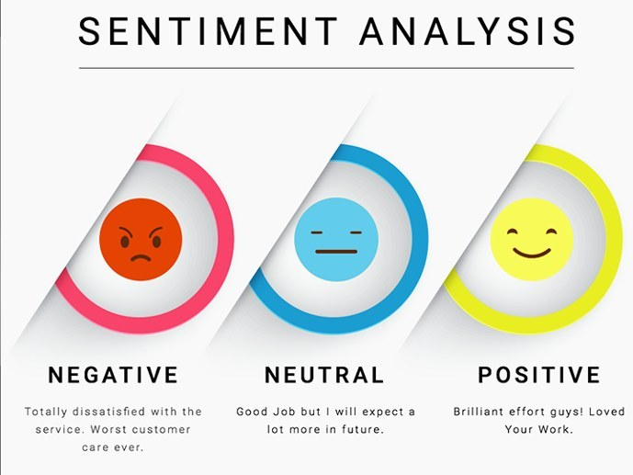

Slide 4
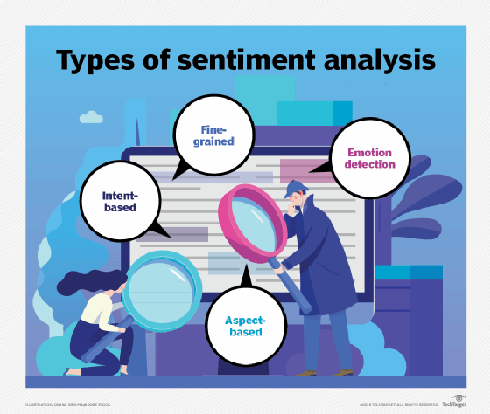

Slide 5
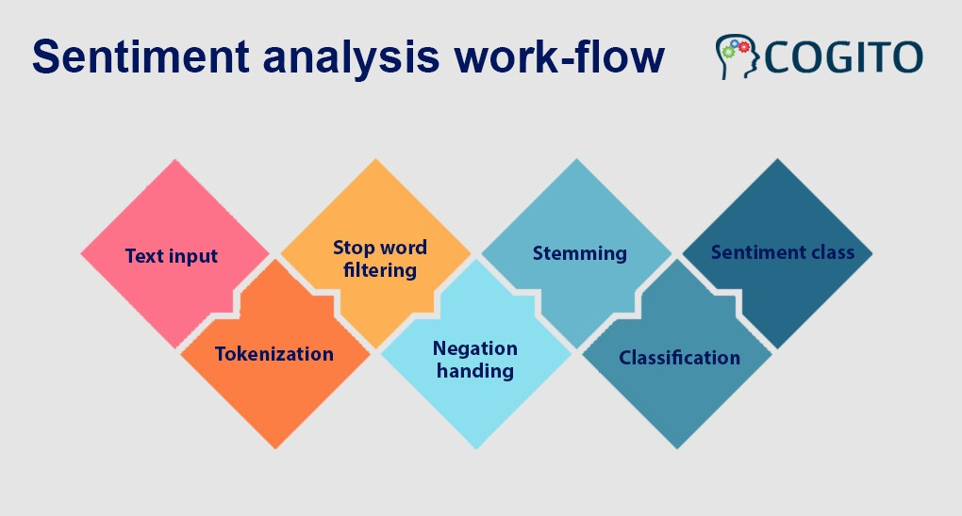

Slide 6
library(tm)
library(wordcloud)
library(syuzhet)
#import data in R
reviews <-read.csv(file.choose(),header=T)
#check the structure of the file
str(reviews)
#creating corpus
#this function used the base package function iconv to translate value labels into a specified
corpus <-iconv(reviews$text)
corpus <-Corpus(VectorSource(corpus))
#to see the corpus
inspect(corpus[1:5])
#cleaning corpus
corpus <-tm_map(corpus,tolower)
inspect(corpus[1:5])
corpus <- tm_map(corpus,removePunctuation)
inspect(corpus[1:5])
corpus <-tm_map(corpus,removeNumbers)
inspect(corpus[1:5])
corpus <- tm_map(corpus,removeWords,stopwords("english"))
inspect(corpus[1:5])
corpus(tm_map(corpus,stripWhitespace))
inspect(corpus[1:5])
reviews_final<- corpus
#create term document
tdm<-TermDocumentMatrix(reviews_final)
tdm<-as.matrix(tdm)
tdm[1:10,1:5]
#bar plot of the words
w<-rowSums(tdm)
w<-subset(w,w>=25)
barplot(w,las=2,col="blue")
corplus<-tm_map(corpus,removeWords,c("buy","calls","button"))
#creat word cloud
w<-sort(rowSums(tdm),decreasing = T)
set.seed(2000)
wordcloud(words = names(w),
freq = w,
max.words = 50,
random.order = T,
min.freq = 5,
colors = brewer.pal(25,"Dark2"),
scale=c(3,0,3))
#obtain sebtiment scores
sentiment_data<- iconv(reviews$text)
s<-get_nrc_sentiment(sentiment_data)
s[1:10]
#calculate review wise score
s$score<-s$positive-s$negative
s[1:10]
#write score into a csv file
write.csv(x-s.file-"C:\Users\Altaf\Desktop\score.csv")
#check product sentiment
#check overall sentiment of the product
review_score<-colSums(s[,])
print(review_score)
#plot product sentiment
#bar plot
barplot(colSums(s),
las=2,
col= rainbow(10),
ylab='count',
main = 'sentiment')

Slide 7
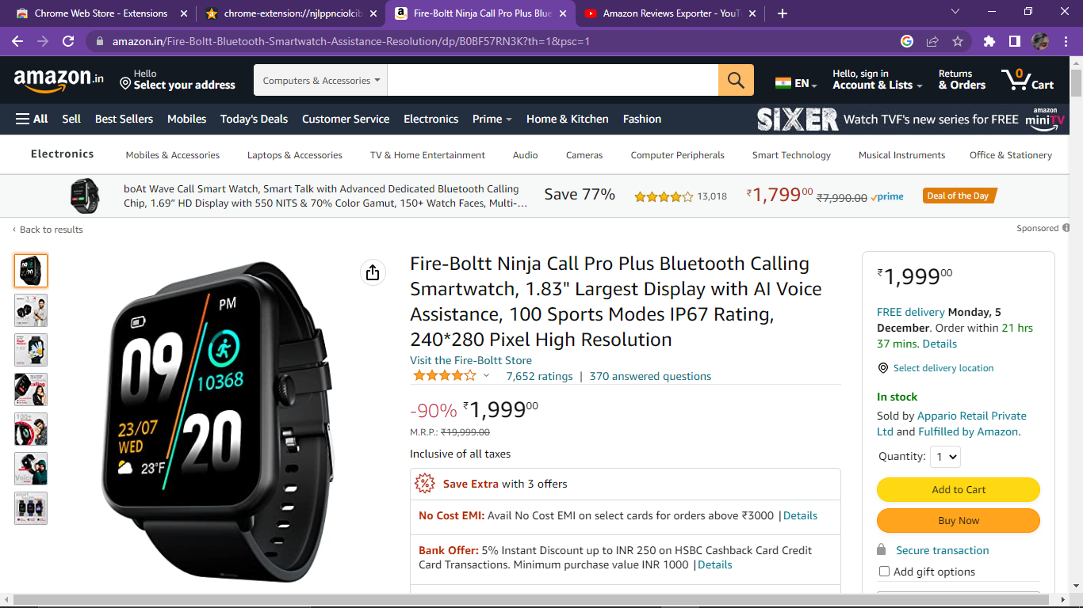
https://www.amazon.in/Fire-Boltt-Bluetooth-Smartwatch-Assistance-Resolution/dp/B0BF57RN3K?th=1&psc=1

Slide 8
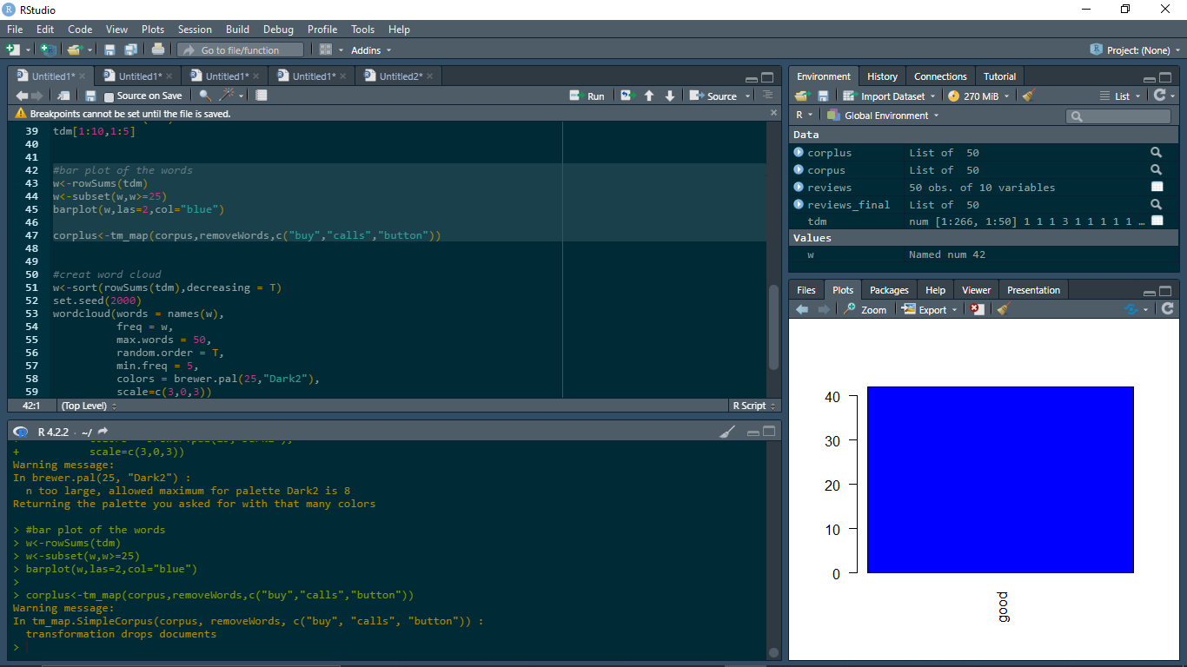

Slide 9
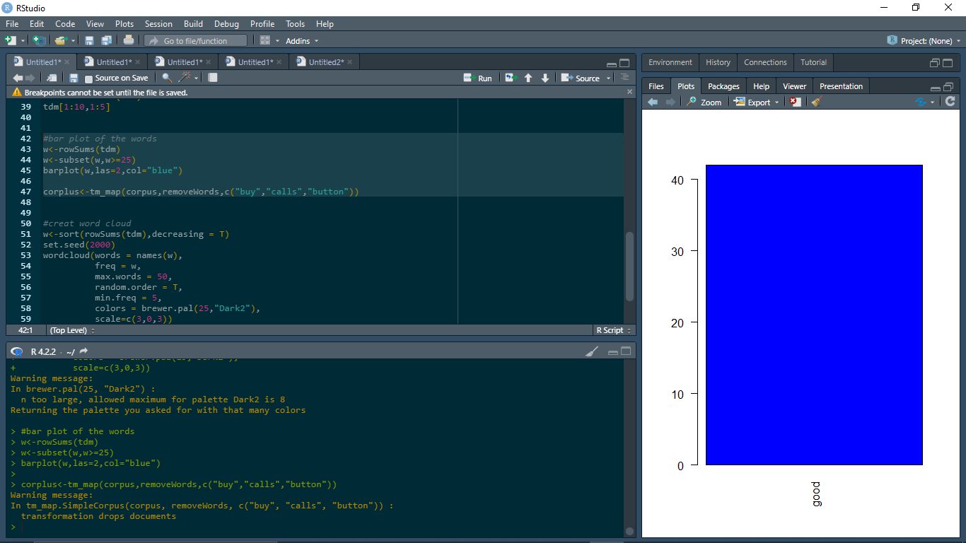

Slide 10
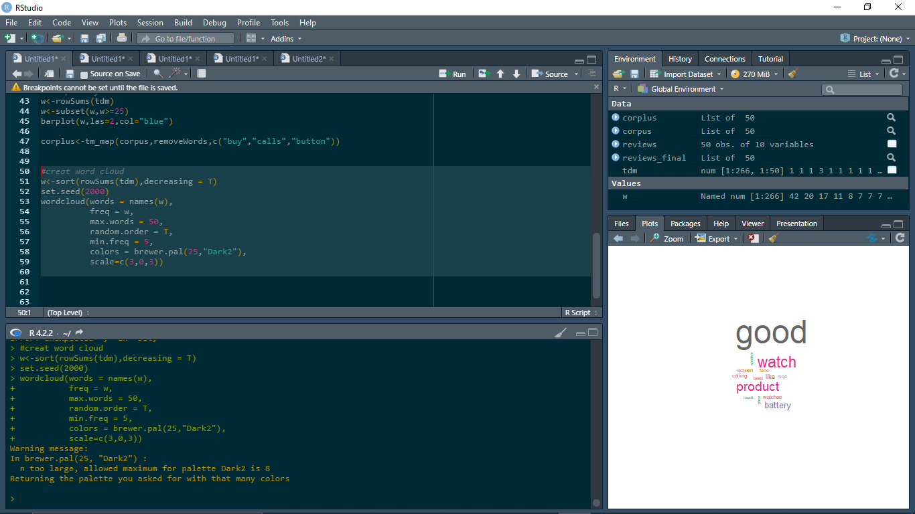

Slide 11
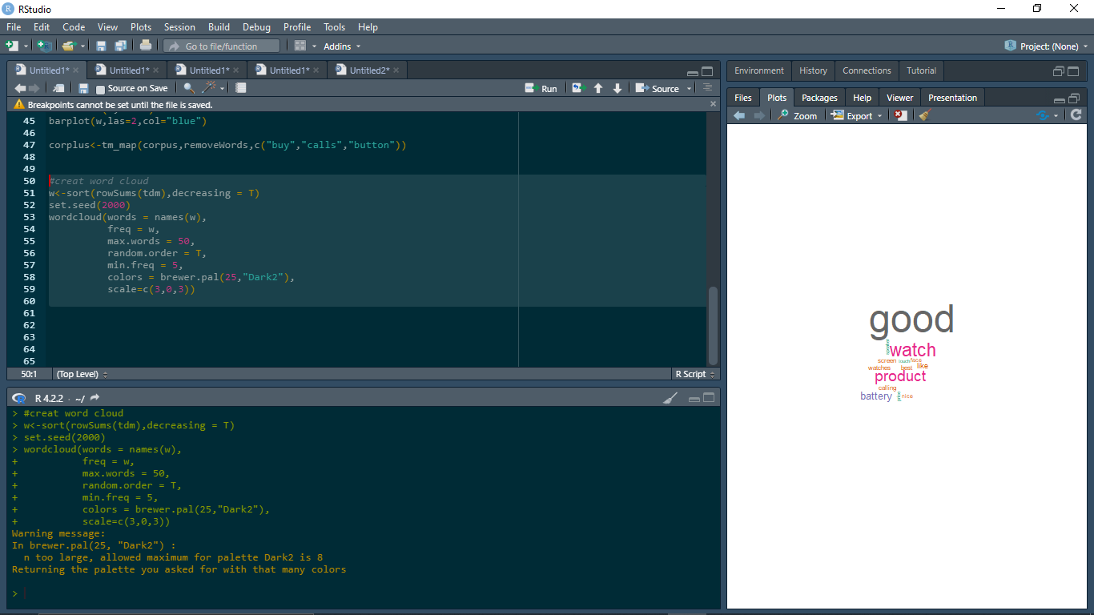

Slide 12
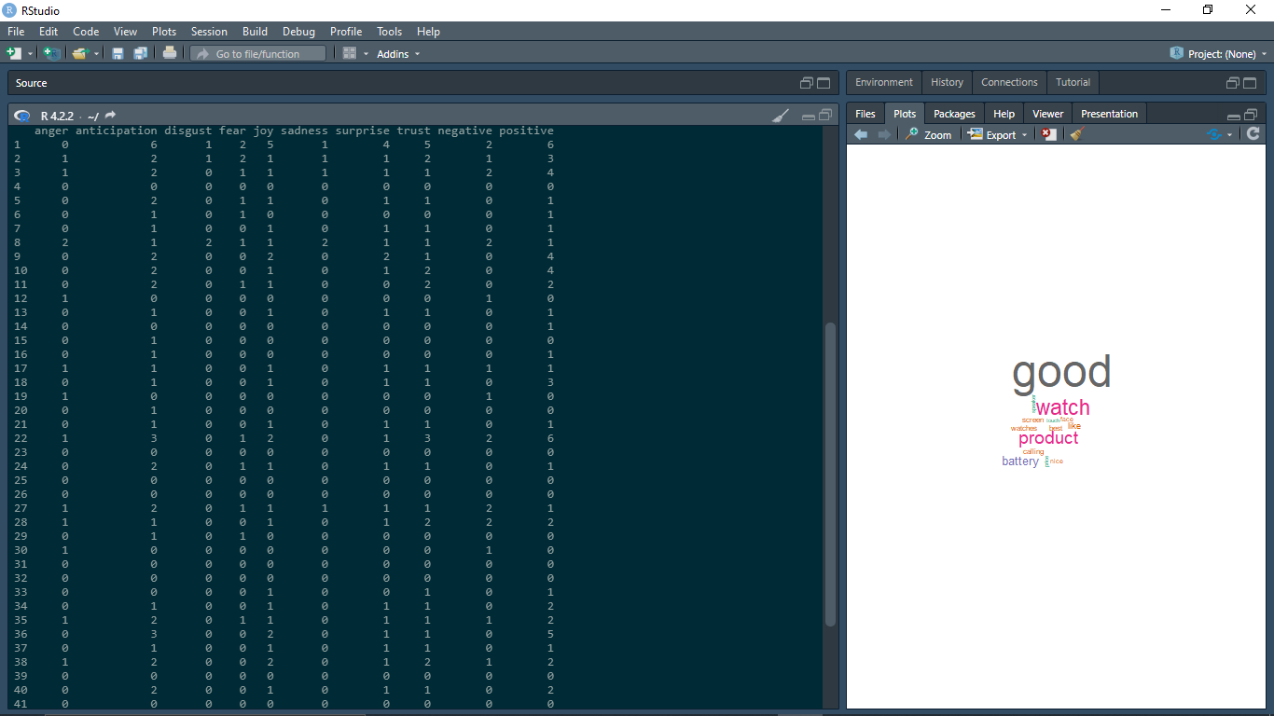

Slide 13
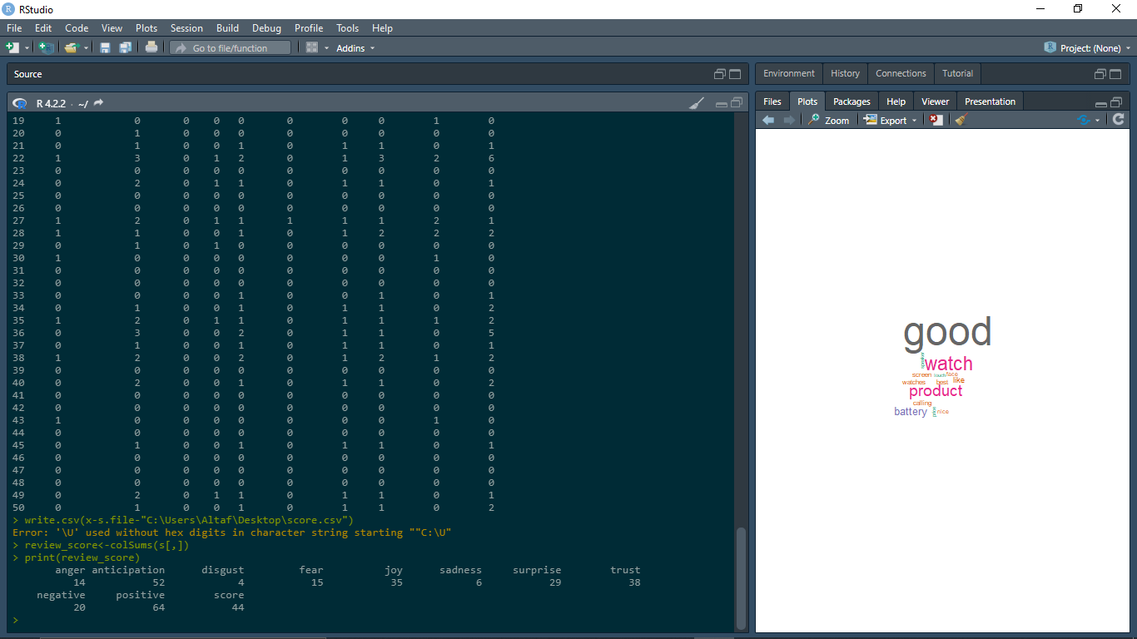
Score

Slide 14
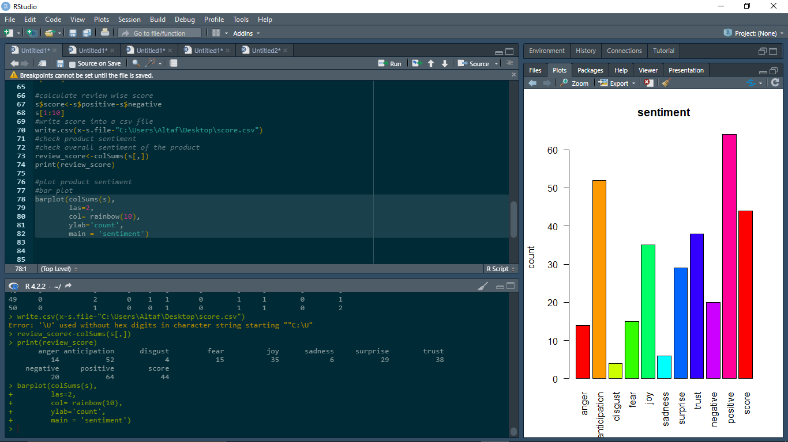

Slide 15
THANK YOU!...

